Slide 1
Welcome to SIA Middle Academy
Parent Orientation Night May 2018
Notes:
We are going to go over the online enrollment packet that will need to be completed by May 31st.

Slide 2
Enrollment
Emailed a link to Skyward Family Access
If link is lost then please click on the red Family Access Login button that can be found on our homepage.
Notes:
You will receive an email with a link to the skyward enrollment packet. If for some reason the email gets deleted you can log into Skyward Family Access through our website. As you can see from our homepage it is the RED family access login button.

Slide 3
Enrollment
You will use this program Skyward Family Access for your enrollment packet as well as checking grades and attendance through out the school year.
Login: the first 5 letters of your last name, the first 3 letters of your first name followed by 3 zeroes
Example: rabbipet000
Temporary Password in ALL CAPS: the first 5 letters of your first name, “!”, first 5 letters of your last name followed by the number 1. Example: peter!rabbi1
*Once you log in you will be prompted to change your password.
Notes:
This is a screen shot of the login. Please make sure that it says Spokane International Academy under Skyward. Other districts use this system, but it is district specific. Skyward Family Access is where you will complete the enrollment packet. You will also use it throughout the school year to check grades and attendance. Your login will be the first 5 letters of your last name, the first 3 letters of your first name followed by 3 zeroes. The temporary password needs to be in all CAPS and it will be the first 5 letters of your first name, followed by an “!” mark followed by the first 5 letters of your last name followed by the number 1. So a password example for Peter Rabbit would be peter!rabbi1. If you have trouble logging in please call the Middle Academy.

Slide 4
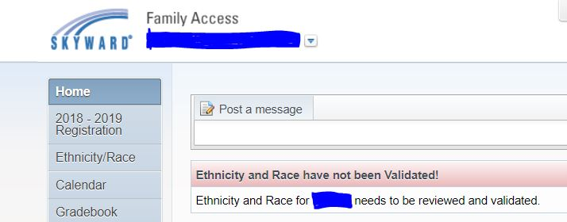
Enrollment
Click on :
“Go to 2018-2019 Registration for your student”
Notes:
Once you login you will see this. Please click on the 2018-2019 Registration for your student.

Slide 5
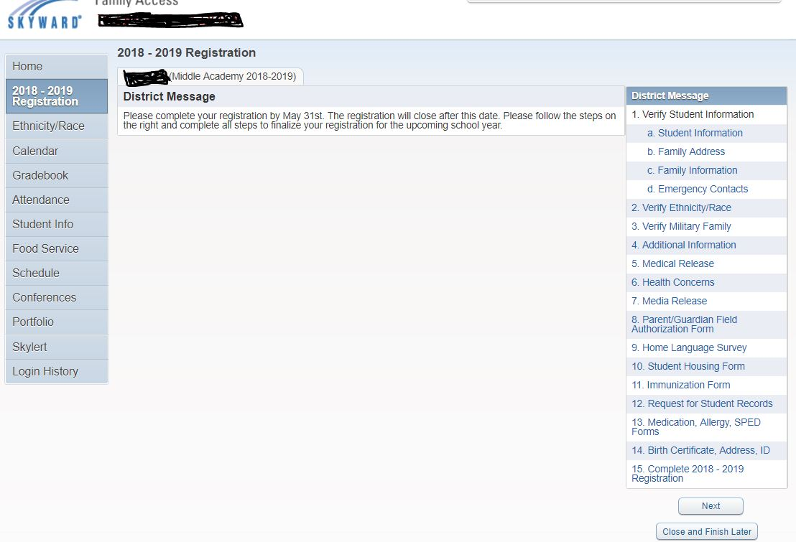
This is the main page of the enrollment packet.
Click on the different sections on the left to complete the packet.
Notes:
Once you have logged in, this is the main screen you will see. Over to the right of the screen, under the district message is where all the steps in the enrollment process can be viewed. Please make sure to complete all 15 steps and please make sure to submit the online registration.

Slide 6
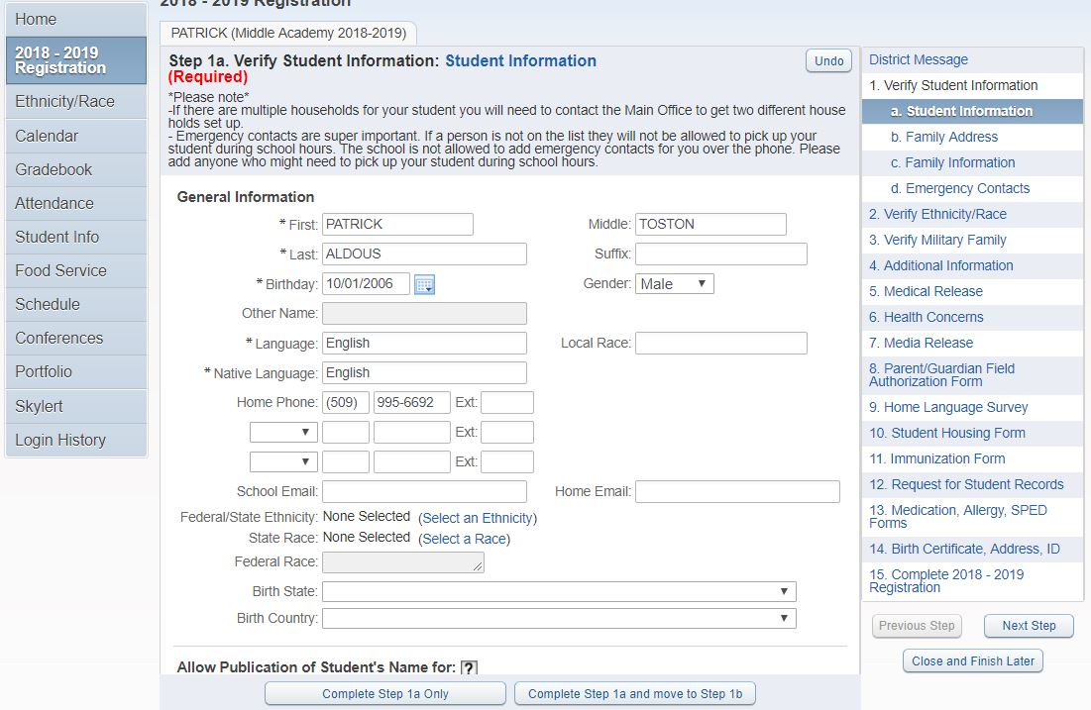
Example of 1st step. Many of the steps will require you to fill in information.
At the bottom you can choose to complete that step then save or continue on to the next step.
Notes:
This is the first step in the process. The packet does not have to be completed in one sitting. At the bottom you can see that you have the option to complete each step individually or move to the next. You can also close and finish later. Please be mindful of the deadline which is May 31st.

Slide 7
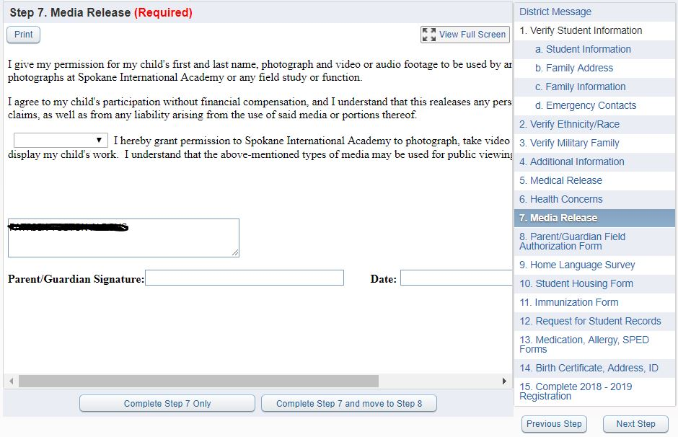
Some of the steps will require you to select an drop down option.
Electronic signatures are also required.
Notes:
Other steps are going to require an electronic signature that will be good for the whole school year and some beyond. This one is a media release for social media sites as well as the yearbook. Please make sure to read them and understand what you are agreeing to.

Slide 8
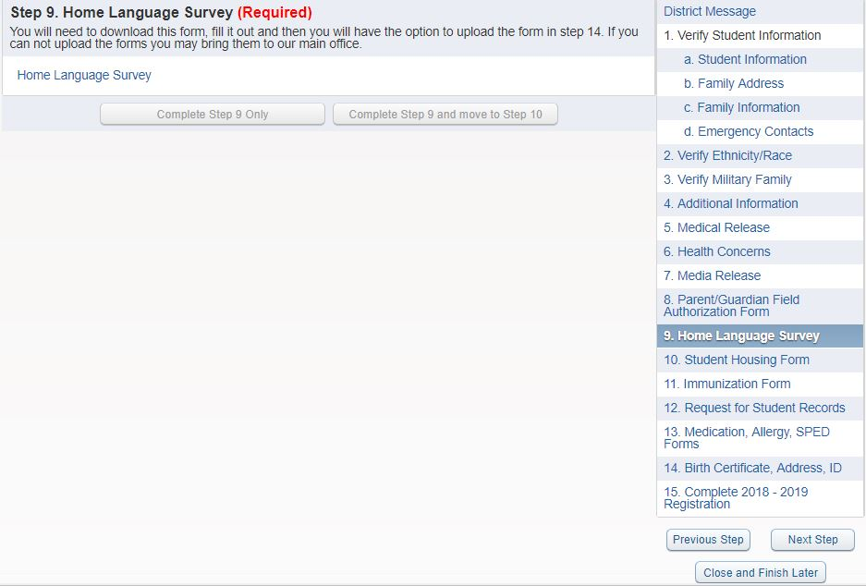
An external document needs to be printed and completed. Once finished please upload in step 15 or email a copy to Middle Academy Main Office.
In order to download please hover over the link. It will become underlined and then you will be able to select it.
Notes:
Some steps will look like this. This is an external document that needs to be download, printed, and uploaded in step 14. If you are unable to upload documents please turn them into SIA Middle Academy through email (maoffice@spokaneintlacademy.org) or please stop by with the hard copy. To download please hover over the form until it becomes underlined. Once it is underlined you can click on it and it should automatically download or take you to a PDF version of the form. At this point you will need to print out the form and complete it. Once it is completed you can scan and upload the document on step 14. If you do not have access to a printer and/or scaner please stop by the main office and we will provide hard copies of the required forms.

Slide 9
Step 13 will direct you to our website where you can find all the forms that you will need. Click on the specific ones to download, print, and bring to SIA.
Notes:
Step 13 will appear like a form to download, however it will take you directly to our website. On our website you will be able to download the forms for your student. Please make sure you select the forms that are required for your student.

Slide 10
Required Health Forms
Food Allergies
Severe Allergies (Hs-634)
Student Diet Prescription
Standard Food Substitutions
Asthma
Asthma Plan and Medication Order
Medication Request Form
Medication at school
Medication Request Form
Severe Allergies (Epi-Pen)
Severe Allergies (Hs-634)
Medication Request Form
Immunization (All Students)
Certificate of Immunization Status
OR
Certificate of Exemption

Slide 11
Health Reminder
If your student(s) need(s) to have any of the items listed below a “Medication Request Form” must be completed by a Licensed Health Professional with Prescriptive Authority:
Chapstick
Ibuprofen, Tylenol or any medication
Cough drops
Gum
*Medical Forms can be found on our website by opening the “Parents” tab and selecting “Additional Enrollment Forms”. Please download and complete all of the required forms.
Notes:
A child is not to bring these items to school without a medical request form. If these items are found they will be in the office and you as a parent will have to come pick the item it up. Also if your child does require medication you as a parent will have to bring it to school; a child can’t bring medication to school or take medication home.
http://apps.leg.wa.gov/RCW/default.aspx?cite=28A.210.260
http://app.leg.wa.gov/RCW/default.aspx?cite=69.41.010

Slide 12
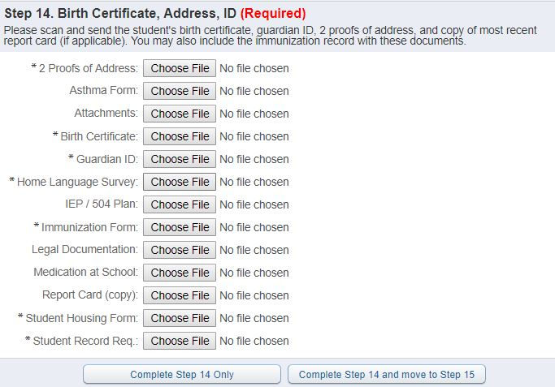
Step 14: Will prompt you to upload the required documents. If you cannot upload these documents we will need to collect hard copies. Please contact the Main Office at the Middle Academy.
Notes:
Required forms to upload are: 2 Proofs of Address, Birth Certification, Guardian ID, Home Language Survey, Immunization, Student Housing Form, Student Record Request.

Slide 13
Enrollment
Documents
Birth Certification (State not Hospital)
Current Immunizations
Photo ID
Two “proof of address” documents (Example: any mail that shows name and address, utility bill with name and address) Photo ID of a guardian does NOT count.

Slide 14
Upcoming Events
Middle Academy International Night
Friday, May 11th from 5:30 pm to 7:00 pm

Slide 15
Thank you!

